Slide 1
SOCIAL MEDIA SENTIMENT ANALYSIS

Slide 2
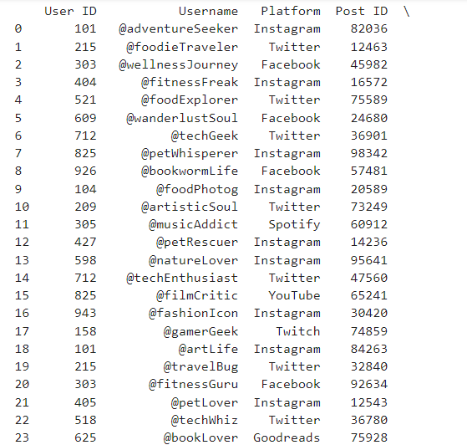
IMPORT CSV FILE
CODE:
import pandas as pd
df = pd.read_csv('social media.csv’)
print(df)

Slide 3
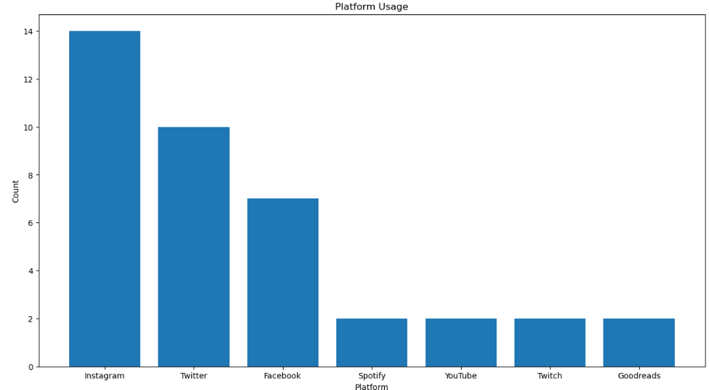
PLATFORM USAGE
CODE:
import pandas as pd
import matplotlib.pyplot as plt
df = pd.read_csv('social media.csv’)
x = df['Platform'].value_counts()
plt.figure(figsize=(15,8))
plt.bar(x.index,x.values)
plt.title("Platform Usage")
plt.xlabel("Platform")
plt.ylabel("Count")
plt.show()

Slide 4
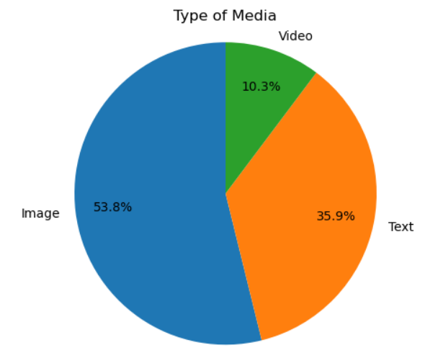
MEDIA TYPE
CODE:
import pandas as pd
import matplotlib.pyplot as plt
df = pd.read_csv('social media.csv’)
x = df['Media Type'].value_counts()
#labels for pie chart
labels = x.index
sizes = x. values
#Explode parameter
explode = tuple([0]*len(labels))
#Plotting the pie chart
plt.pie(sizes, explode=explode, labels=labels, autopct ='%1.1f%%', startangle=90, pctdistance=0.75)
#Plotting the title
plt.title("Type of Media")
plt.axis("equal")
#Show the plot
plt.show()

Slide 5
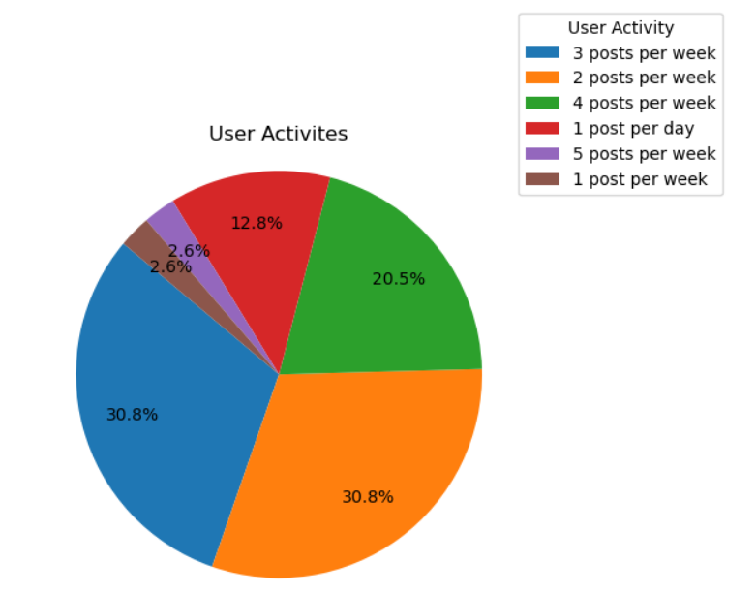
USER ACTIVITIES
CODE:
import pandas as pd
import matplotlib.pyplot as plt
df = pd.read_csv('social media.csv’)
x = df['User Activity'].value_counts()
#labels for pie chart
sizes = x. values
#Explode parameter
explode = tuple([0]*len(labels))
#Plotting the pie chart
plt.pie(sizes, explode=explode, autopct ='%1.1f%%', startangle=140, pctdistance=0.75)
#Plotting the title
plt.title("User Activites")
plt.axis("equal")
plt.legend(labels=x.index,loc=(0.9,0.9),title="User Activity")
#Show the plot
plt.show()

Slide 6
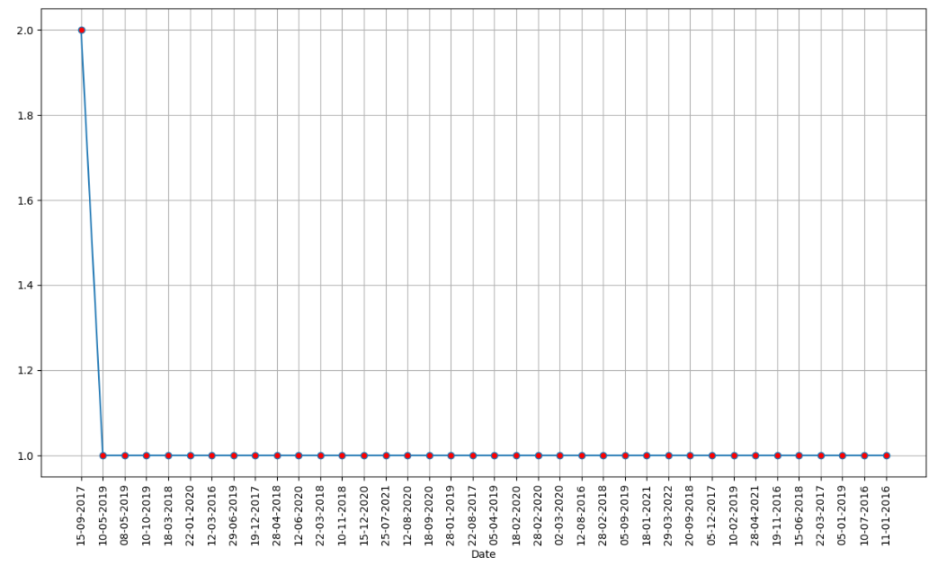
ACCOUNT CREATION DATE
CODE:
import pandas as pd
import matplotlib.pyplot as plt
df = pd.read_csv('social media.csv’)
x = df['Account Creation Date'].value_counts()
plt.figure(figsize=(15,8))
plt.plot(x.index, x.values, marker='o', mfc='r’)
plt.xticks(rotation=90)
plt.xlabel("Date")
plt.grid()
plt.show()

Slide 7
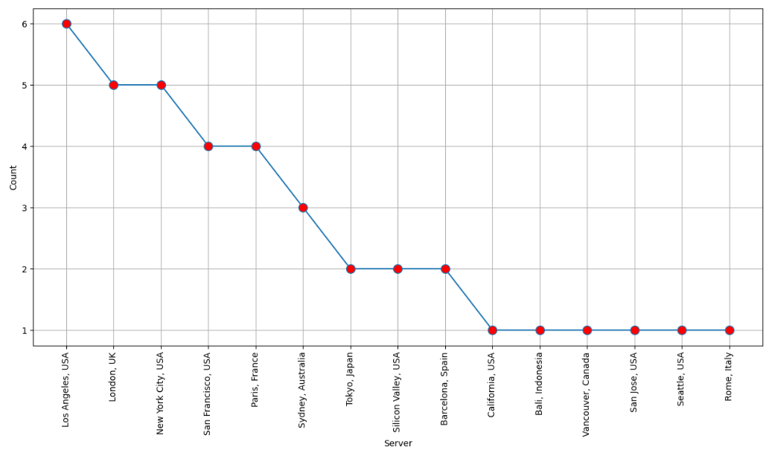
SERVER POST
CODE:
import pandas as pd
import matplotlib.pyplot as plt
df = pd.read_csv('social media.csv’)
x = df['Server Post'].value_counts()
plt.figure(figsize=(15,7))
plt.plot(x.index, x.values, marker='o', mfc='r', ms=10)
plt.xticks(rotation=90)
plt.xlabel("Server")
plt.ylabel("Count")
plt.grid()
plt.show()

Slide 8
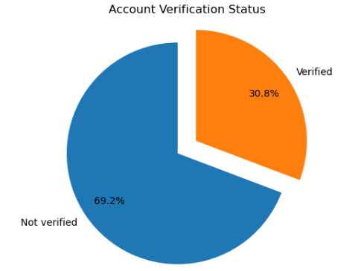
ACCOUNT STATUS
CODE:
import pandas as pd
import matplotlib.pyplot as plt
df = pd.read_csv('social media.csv’)
x = df['Account Verification'].value_counts()
#labels for pie chart
labels = x.index
sizes = x. values
#Explode parameter
explode = tuple([0.1]*len(labels))
#Plotting the pie chart
plt.pie(sizes, explode=explode, labels=labels, autopct ='%1.1f%%', startangle=90, pctdistance=0.75)
#Plotting the title
plt.title("Account Verification Status")
plt.axis("equal")
#Show the plot
plt.show()

Slide 9
LIKES - MEAN, STANDARD DEVIATION, MINUMUM, MAXIMUM, RANGE
CODE:
import pandas as pd
import numpy as np
# Load data
df = pd.read_csv('social media.csv’)
# Convert a column to a NumPy array
likes_score = df["Likes/Reactions"].to_numpy()
#mean
mean_score = np.mean(likes_score)
#std deviation
std_dev_score = np.std(likes_score)
#Minumum
min_val = np.min(likes_score)
# Maximum
max_val = np.max(likes_score)
# Range
range_val = np.ptp(likes_score)
print("Mean of likes:", mean_score)
print("Standard deviation:", std_dev_score)
print("Minimum:", min_val)
print("Maximum:", max_val)
print("Range:", range_val)
OUTPUT:
Mean of likes: 967.1794871794872
Standard deviation: 397.67238621597977
Minimum: 370
Maximum: 2200
Range: 1830

Slide 10
THANK YOU!

